Slide 1
DevOps
ADOP Gen5 Activities Day2

Slide 2
Course Map/Module Map
Use these slides as needed (Right click stage->Layout->CourseMap_Module#)
Operations
Platform Applications
Containers - Docker
IOC - Chef
Module Map
Stack creation for Day2
Create chef environment
Pushing application to repository
Checking Pipeline
Module Map
Stack creation for Day2
Create chef environment
Pushing application to repository
Checking Pipeline
Module Map
Stack creation for Day2
Create chef environment
Pushing application to repository
Checking Pipeline
Module Map
Stack creation for Day2
Create chef environment
Pushing application to repository
Checking Pipeline

Slide 3
Module Objectives
At the end of this module, you will be able to:
Describe Configuration Management using Chef
Describe Containers and Docker
Use platform application features
Perform Operations in cloud
Notes:
Action verbs: abstract, acquire, adjust, agree, analyze, apply, appraise, argue, assess, avoid, breakdown, build, calculate, carry out, catalog, clarify, classify, combine, compare, compute, conclude, construct, contrast, convert, cooperate, create, criticize, defend, define, demonstrate, derive, describe, design, detect, determine, differentiate, discover, discriminate, discuss, dissect, distinguish, employ, estimate, evaluate, examine, explain, explore, formulate, generalize, help, identify, illustrate, implement, indicate, inspect, instruct, integrate, interpret, investigate, join, judge, justify, label, list, master, measure, move, name, observe, offer, operate, order, organize, participate, perform, plan, praise, predict, prepare, produce, propose, rank, recall, recognize, relate, repair, represent, reproduce, research, restate, resolve, select, sequence, solve, specify, state, summarize, support, systematize, taste, test, theorize, transform, translate, use, utilize, verify, weigh, write, etc.

Slide 4
Module 5 Activities: Convergent Configuration Management Using Chef

Slide 5
Pre-requisite
If you completed day 1 and didn't delete your stack, you don't need to do anything and can continue with yesterday's environment
If you did delete the stack yesterday follow the create stack part of this page only

Slide 6
Setting Up Chef server
To load your chef platform extension, access Jenkins once your DevOps Academy stack is up and running through the public IP in the stack outputs: http://<public-IP>/jenkins
Go into the Platform Management folder and access the Load_Platform_Extension job:
http://<publicIP>/jenkins/job/Platform_Management
/job/Load_Platform_Extension/
Click on "Build with parameters"
Enter the following URL in the GIT_URL parameter:
https://github.com/Accenture/adop-platform-extension-chef
Leave the GIT_REF as the default value (master)

Slide 7
Setting Up Chef server
For the AWS_CREDENTIALS parameter, use the Add dropdown box to enter a new username and password credential set
For Username, enter the Access Key ID given which you entered during the DevOps Academy stack creation
For Password, enter the Secret Access Key which you were given
In case it is already in the list, select it
Click on the “Build” button
The chef server takes approximately 30 minutes to load
New stack will get created for this activity

Slide 8
Login To Chef Server
Click on the console output of your build of the Load_Platform_Extension job
You will be given a URL (in the form https://EC2-Service-Extension-1.<public-IP>.xip.io) at the bottom once the build has succeeded
If you get an error, use Chrome as a browser and choose to ignore the expired SSL certificate
The credentials to access your chef server through the user interface are as follows:
Username: admin
Password: admin@1

Slide 9
Security Pre-requisites
Before we load the chef pipeline we have to setup credentials to allow jenkins to interact with chef server. Jenkins needs two private keys -
Admin Key : This is to allow jenkins to interact with chef server and perform action like uploading cookbooks etc.
Chef Validator Key : This is to allow jenkins to bootstrap a node (server) against chef server.
We have to reset both the keys and add them as credentials to jenkins so that they are available for chef pipeline

Slide 10
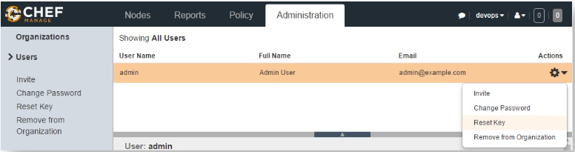
Reset Admin Key
Open a browser and go to
https://EC2-Service-Extension-1.<public-IP>
.xip.io/organizations/devops/users/admin
Reset the private key for admin user
Copy the private key in the block and click on the "Download" button
Include the header and footer sections, and save it as "admin.pem"

Slide 11
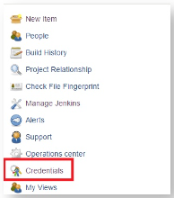
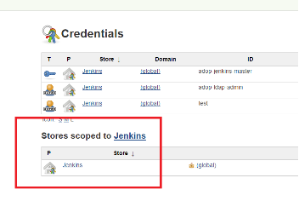
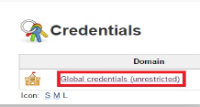
Add Admin Key To Jenkins
Open a browser and got to at http://<public IP>/jenkins
Click on "Credentials" link
Navigate to the "Jenkins" scope
Then navigate to "Global Credentials" -> "Add Credentials "

Slide 12
Add Admin Key To Jenkins
Select Kind as "SSH Username with private key "
Leave the Scope as it is
Username should be admin
For the "Private Key" select the "Enter directly" and in the text box you need to add the private key which we copied in the "Reset Admin Key" section.
Leave the passphrase as blank.
Description should be "chef admin user“
Click “OK”

Slide 13
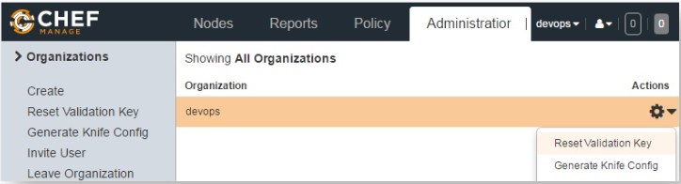
Reset Chef Validator Key
Go to your chef server and click on the Administration -> Organizations -> devops
Reset the validation key
Copy the private key in the block
Click on the "Download" button
Include the header and footer and save it as "devops-validator.pem"

Slide 14
Add Chef Validator Key To Jenkins
Open a browser and got to at http://<public IP>/jenkins
Click on "Credentials" link
Navigate to the "Jenkins" scope
Then navigate to "Global Credentials" -> "Add Credentials "
Select Kind as "SSH Username with private key "
Leave the Scope as it is
Username should be devops-validator

Slide 15
Add Chef Validator Key To Jenkins
For the "Private Key" select the "Enter directly" and in the text box you need to add the private key which we copied in the "Reset Chef Validator Key" section.
Leave the passphrase as blank.
Description should be "chef validator"
Click “OK”

Slide 16
Loading Chef CI Pipeline
Navigate to the DOA/job/Labs/job/Module5_Chef/ job/Generate_Chef_Pipeline_Jobs/
Click "Build with parameters“
Enter following parameters -
CHEF_SERVER_ORGANIZATION_URL :
https://EC2-Service-Extension-1.<public-IP>
.xip.io/organizations/devops
CHEF_SERVER_USERNAME : Select the credential for admin user which we added in last section
CHEF_SERVER_VALIDATOR : Select the credential for devops-validator user which we added in last section
Click "Build". Once the job is finished, it will generate Jenkins jobs and the pipeline view for chef CI

Slide 17
Configuring Workstation
Clone "adop-cartridge-chef-reference-cookbook" from Gerrit
git clone http://<public-IP>/gerrit/DOA/Labs/Module5
_Chef/adop-cartridge-chef-reference-cookbook
Provide the userId / password you created with stack
Make a change to a file in the adop-cartridge-chef-reference-cookbook
Create a directory ".chef“ in cloned repository
cd /c/Data/DevOpsAcademy/adop-cartridge-chef-reference-cookbook
mkdir .chef
Create a knife.rb file inside .chef directory

Slide 18
Configuring Workstation
Copy the following configuration
Update the <chef_server_url> with your chef server url
(for example - https://EC2-Service-Extension-1.<public-IP>.xip.io/organizations/devops)
me(__FILE__)
home = ENV['HOME']
user = ENV['OPSCODE_USER'] || 'admin'
org = ENV['ORGNAME'] || 'devops'
node_name user
client_key "#{user}.pem"
validation_client_name "#{org}-validator"
validation_key "#{org}-validator.pem"
chef_server_url "https://<chef_server_url>/organizations/#{org}"
syntax_check_cache_path "syntax_check_cache"
ssl_verify_mode :verify_none
cookbook_copyright 'Accenture'
cookbook_license ''
cookbook_email 'youremail@accenture.com'

Slide 19
Configuring Workstation
Copy the admin.pem and devops-validator.pem files downloaded earlier in this exercise to .chef directory
This completes the chef setup on your workstation
Push changes made
cd adop-cartridge-chef-reference-cookbook
git add .
git commit -m "Added knife configuration"
git push origin master
This automatically trigger the Get_Cookbooks job in Jenkins
Access the cookbooks available on your chef server
https://EC2-Service-Extension-1.<public-IP>.xip.io/organizations/devops/cookbooks

Slide 20
Next few steps related to Chef will not work
This will change in near future

Slide 21
Chef_Converge_On_Node
If the changes are successfully uploaded to the Chef Server, the final step is to deploy the updated change onto the relevant node
Chef node's should be converging perpetually, every 30 minutes and will automatically pick up any cookbook changes
However, we will force a converge by executing the chef-client command to initiate the converge process
knife node run_list add training_node 'tomcat’
knife ssh name:training_node -i $WORKSPACE/workspace/academy_key.pem -- no-host-key-verify -x root "sudo chef-client"

Slide 22
Deploying Sample App to Chef Node
Go to the Chef Node instance
http://<public-ip>/academy_petclinic
It will not be available
Navigate to the Deploy_to_chef_tomcat Jenkins job under the Module 5 Jobs view.
To deploy the application click the "Build with Parameters" link
The TOMCAT_IP should be the private IP of Chef node
Then click the build button.
The petclinic application will be deployed and should be accessible from
http://<public-ip>/academy_petclinic
Please note it can take a few minutes for the application to start

Slide 23
Module 6 Activities: Containers with Docker

Slide 24
Introduction
Docker is an open platform for developers and sysadmins to build, ship, and run distributed applications
Consisting of Docker Engine, a portable, lightweight runtime and packaging tool, and Docker Hub, a cloud service for sharing applications and automating workflows
Docker enables apps to be quickly assembled from components and eliminates the friction between development, QA, and production environments
As a result, IT can ship faster and run the same app, unchanged, on laptops, data center VMs, and any cloud

Slide 25
Pre-Requisite
You are required to sign up to Docker Hub at https://hub.docker.com/
You will push your built docker images to your public docker registry
You will need to provide Jenkins with the credentials of your Docker Hub account
If you already have an account, you don't need to follow this step
If you don't, sign up with a username, email address and password and make a note of these values

Slide 26
Add Docker Credentials To Jenkin
Open a browser and got to at http://<public IP>/jenkins
Click on "Credentials" link
Navigate to the "Jenkins" scope
Then navigate to "Global Credentials" -> "Add Credentials "

Slide 27
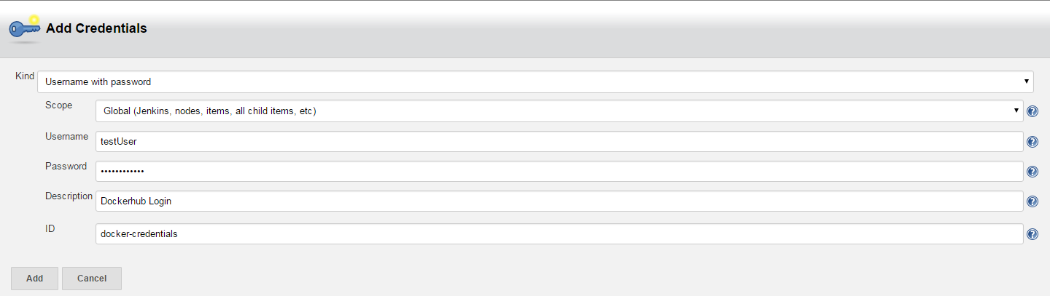
Add Docker Credentials To Jenkin
Ensure that the "Kind" of credentials are "Username with password".
Add your docker username and password
The description is an optional field to help you identify your credentials easily
Add the ID "docker-credentials". The Module 6 jobs are configured to look for that ID by default

Slide 28
Trigger Docker Pipeline
Access the 'Module 6 - Docker CI' view on your Jenkins instance
http://<public-IP>/jenkins/job/DOA/job/Labs/
job/Module6_Docker/
Click on the "Get_Dockerfile" job so that we can trigger the pipeline
Click on "Build with Parameters"
For the DOCKER_LOGIN parameter select your newly added credentials
Leave the IMAGE_REPO field to the default
The IMAGE_TAG can be changed to something more meaningful to you (e.g. name.surname_tomcat8)

Slide 29
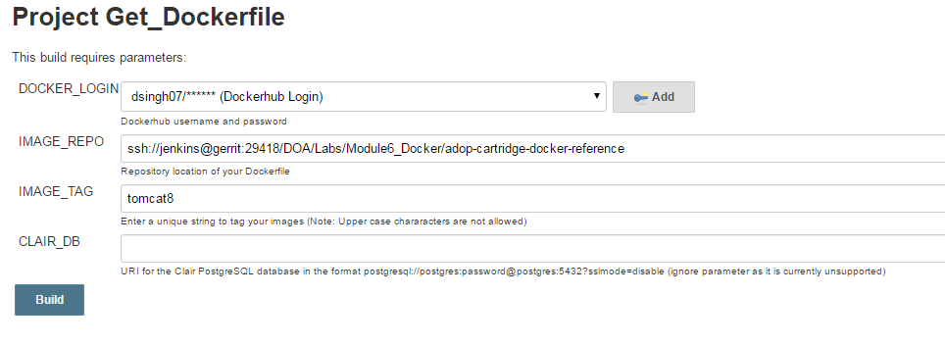
Trigger Docker Pipeline
Leave the CLAIR_DB field as the default blank value
Once you have verified all the credentials are correct, click on "Build" to trigger the pipeline

Slide 30
Explore The Pipeline
Access the pipeline view at
http://<Public-IP>/jenkins/job/DOA/job/Labs/job/
Module6_Docker/view/Sample_Docker_CI/
Steps executed are
Static code analysis on the raw Dockerfile using an external tool called Dockerlint
Image_Build job will build the Tomcat image from scratch
If the image build fails with the following message: Some index files failed to download. Simply rebuild the pipeline by triggering the Get_Dockerfile job
It's possible that this issue might occur in the Container_Test job as well

Slide 31
Explore The Pipeline
The Vulnerability_Scan job will currently do nothing
The Image_Test and Container_Test jobs will build a testing image and run some standard tests against it, defined in our Dockerfile repository
Once we have passed all stages in the pipeline up to now, we will push our built and tested image to Docker Hub using the credentials provided in the Image_Push job
Finally, we pull the image we just pushed from Docker Hub and run it in a container in the Container_Deploy job

Slide 32
Ensure Pushed Image in Docker Hub
Once the Image_Push job has completed, log onto Docker Hub using your credentials
You should be able to see a list of "Repositories" where you will see an image with a tag in the form: dockerhub_username/tag_that_you_provided
When you click on "Details", you will be able to see further information about the image
The Container_Deploy job will pull the above pushed job and run it as a container
The final job (optional) in the pipeline, Container_Cleanup, is used to delete the containers we just deployed

Slide 33
Optional Step To Use Docker Image
This step has to be done before deleting the image
You can open docker application on your machine
Pull the newly created image using Kitematic application
Open tomcat using browser

Slide 34
Topic 3
Module 7 Activities: Platform Application Features

Slide 35
Introduction
AWS CloudFormation is a service that helps us model and set up our Amazon Web Services resources so that we can spend less time managing those resources and more time focusing on our applications that run in AWS
We create a template that describes all the AWS resources that we need (like Amazon EC2 instances or Amazon RDS DB instances), and AWS CloudFormation takes care of provisioning and configuring those resources

Slide 36
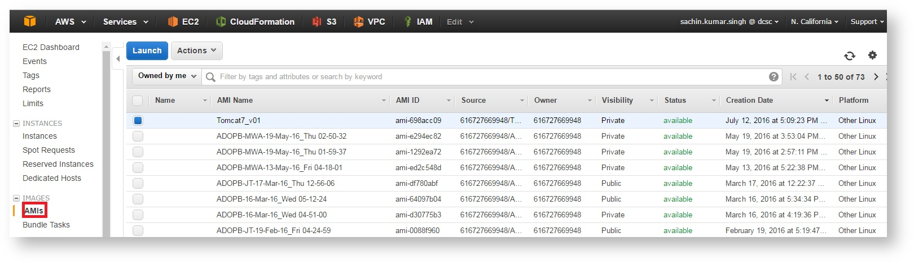
Amazon Machine Images (AMI)
Available AMIs are visible by clicking the
IMAGE -> AMIs link in left panel in EC2 Dashboard of AWS Console - Select Owned by me dropdown
->Select 'Public Images'

Slide 37
Create Stack With Tomcat 7
Create the Initial Stack
The "Tomcat_7.json" template file is available inside the Lab_Modules/Module_7 folder in the adop-doa-materials repository
Edit this file to change the Instance Name of the Instance to be launched from this file
The name of our instance will be governed by the text in the "Value" field of Tags section of "WebServerGroup" resource in our template file

Slide 38
Create Stack With Tomcat 7
"Tags" : [
{
"Key" : "Name",
"Value" : "Academy-Module7-Tomcat7",
"PropagateAtLaunch" : "true“
}
]
Note Down Following
VpcID and PublicSubnetID of your DevOps Academy stack
You can get either value by looking at your CloudFormation stack and choosing the "Resources" tab, then looking for "PublicSubnet" and "Vpc"

Slide 39
Create Stack With Tomcat 7
Log in to the AWS console and navigate to the CloudFormation service.
Click "Create Stack"
On the Create A New Stack screen
Select Upload template file and browse to the file "Tomcat_7.json", and then click Next Step
On the next screen enter the stack details
Type a unique text in the Name box to avoid conflicts with other stack
Select the same key-pair that you used to create your DevOps Academy stack
Select the VpcID and PublicSubnetID of your DevOps Academy stack from the list of options

Slide 40
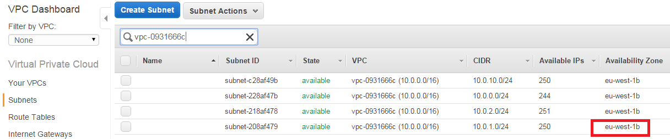
Create Stack With Tomcat 7
Find the availability zone of your stack from Dashboard -> AWS VPC -> Subnets, filtering using your VPC ID and replace the default value
Click Next
Tag the stack with "CreatedBy" key then click Next
On the Review screen, verify that all the settings are as you want them, and then click Create

Slide 41
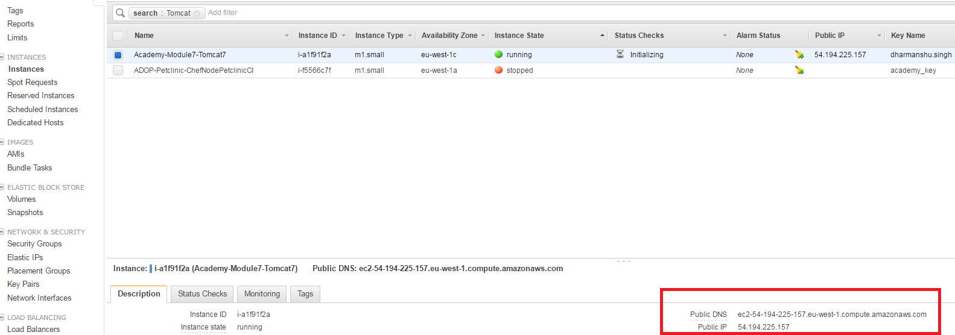
Check The Stack
After the status of our stack is CREATE_COMPLETE, we can get the DNS and Public IP address assigned to our instance by selecting it from the list of instances
Verifying the newly created Tomcat 7 Instance by using it's Public IP address
By hitting the URL, the default Tomcat 7 web page should be visible

Slide 42
Patching Tomcat Version
To update the stack from the AWS Management Console
Log in to the AWS CloudFormation console
On the AWS CloudFormation dashboard, click the stack you created previously, and then click Update Stack
In the Actions, you will find Update Stack wizard, on the select Stack screen, select Upload template file, select the modified template (Tomcat_8.json), and then click Next Step
In the next page, leave the values as they were
Click Next Step because the stack doesn't have a stack policy
On the Review screen, verify that all the settings are as you want them, and then click Update

Slide 43
Verify Patched Version Of Tomcat
When our stack is in the UPDATE_COMPLETE state, the changes are committed to AWS
Again hit the URL of the tomcat server
There is no new change to the instance
Go to the EC2 service within the AWS console and stop the Tomcat instance that we previously created
Right Click instance -> Instance State -> Stop
AWS auto-scaling facility will launch a new instance to replace it
We can verify if Tomcat 8 is running on our newly launched instance by using it's Public IP address

Slide 44
Application Deployment
Login to Jenkins
Run the Deploy job:
Access the Module 7 and 8 jobs from:
http://<Public-IP>/jenkins/job/DOA/job/Labs/job/
Module7_Module8_Labs/
Select the "Module_7_Deploy_to_Tomcat" job from the dashboard
Click "Build with Parameters" from the left hand pane
Click "Add" next to SSH_KEY
Select "Secret file" as your "Kind" of credential
Click on "Choose File" and select your .pem file, created and downloaded at the start of the Academy on Day 1
Click on "Add"

Slide 45
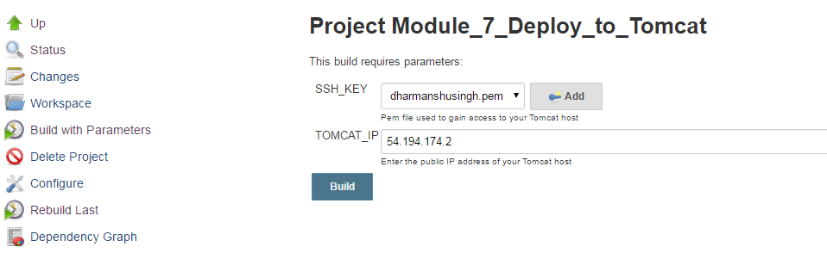
Application Deployment
Provide <Academy-Module7-Tomcat8> to the "TOMCAT_IP" field
Click "Build"
Verify deployment
Go to the DevOps Academy Tomcat 7 instance http://<Academy-Module7-Tomcat8>/petclinic

Slide 46
Topic 4
Module 8 Activities: Operations

Slide 47
Introduction
An important aspect of DevOps is to monitor the health of the infrastructure under management
Many monitoring tools are available to do this, however specifically for this module the focus will be on Cloud Watch which is a monitoring tool provided by AWS

Slide 48
Monitoring using Cloud Watch
Login to the AWS console
Click "Services" and then "EC2“
Click "Instances" and then look for your Tomcat 8 server which you created in the previous module
Click "Monitoring“ tab which exists in the bottom of the page.
This will bring up the monitoring window detailing the different server resources being monitored
The graphs can be drilled into further by selecting a particular resource

Slide 49
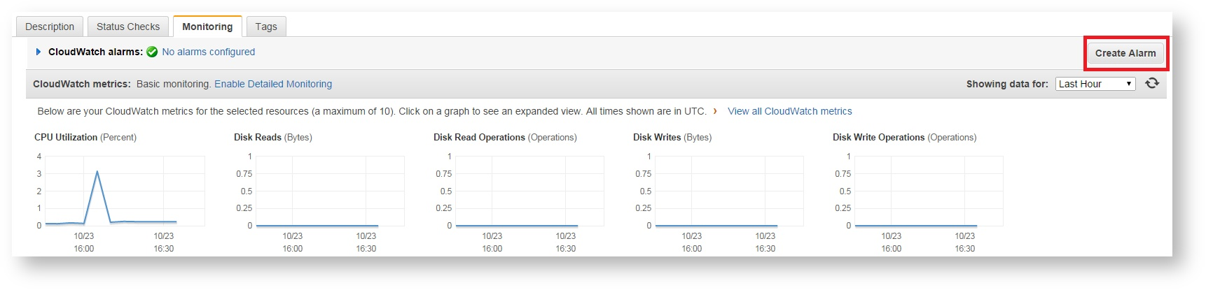
Creating AWS CloudWatch Alarms
Go to the monitoring screen for your Tomcat 8 host
Click “Create Alarm”
On the pop-up window click "create topic"

Slide 50
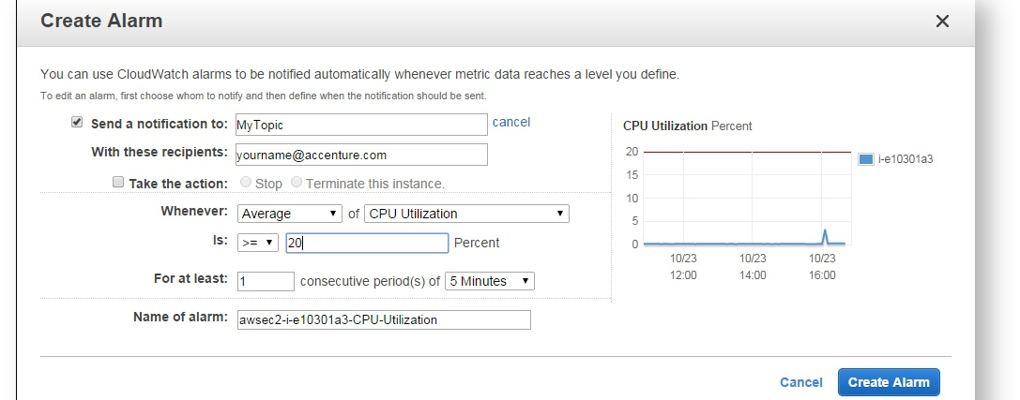
Creating AWS CloudWatch Alarms
Fill in the details as shown below (take note of topic name)
Click "Create Alarm" and "Close"
Confirm subscription: AWS would have sent you an email asking to confirm the subscription to the topic
Click the link to subscribe in the email

Slide 51
Subscribe To Alarm
Click "Services" and then "SNS"
Click "Topics" and select the topic you just created (with your name next to it)
Click "Actions -> Subscribe to topic"
Change the protocol to "email"
Enter your email address in Endpoint
Click "Create Subscription"
Confirm subscription
AWS would have sent you an email asking to confirm the subscription to the topic
Click the link to subscribe in the email

Slide 52
Triggering Cloud Watch Alarm
Login to Jenkins and access the Module 7 and 8 jobs folder at
http://<Public-IP>/jenkins/job/DOA/job/Labs/job/ Module7_Module8_Labs/
Run the "Module_8_Trigger_Alarm" job:
Select the "Module_8_Trigger_Alarm" and click "Build with Parameters" from the job dashboard
Select SSH key which is already added to Jenkins from the dropdown
Paste in the server IP for your Tomcat 8 host for TOMCAT_IP
Click on "Build"

Slide 53
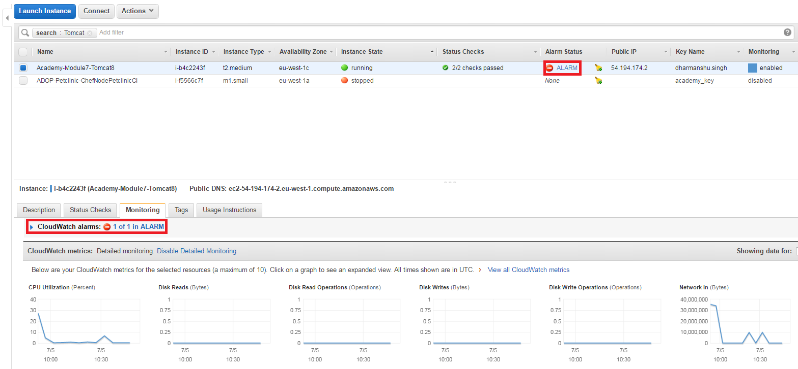
Receive Notification
From triggering the job it can take up to five minutes for an email to arrive notifying that the alarm has been triggered
The changes can also be seen on AWS
Select "EC2 ->Instances"

Slide 54
Kibana Dashboard
Navigate to the your Nginx homepage
http://<Public-IP>
click the Kibana Dashboard link to see the default dashboard
It shows all logs shipped to Logstash through syslog

Slide 55
End Of Day2
Please refer to the End of Day 1 instructions for deleting the stack you created in day 2
Note: You will need to delete any additional stacks that were created during the day i.e. Chef server and Tomcat servers
Please ask participants to delete their stacks

Slide 56
Summary
At the end of this course, you are able to:
Describe Configuration Management using Chef
Describe Containers and Docker
Use platform application features
Perform Operations in cloud

Slide 57
Reference
https://alm.accenture.com/wiki/display/DOT/Application+Deployment

Slide 58
Thank You

